Slide 1

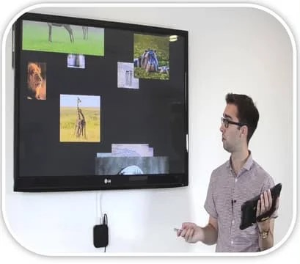

The impact of social media on education
Understanding the role of digital platform in learning

Slide 2


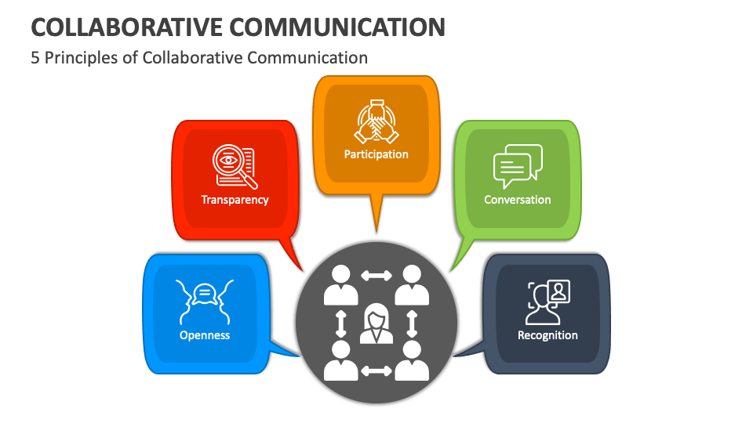
Introduction
Social media has changed how students interact and learn.
It influence communication, collaboration, and access to information.

Slide 3



Positive effects
Enhance learning through video and article
Encourage collaboration through group chats and forums
Offers real-time updates and discussions

Slide 4


Access to education content
Student can follow educational pages and influences
Access to tutorials, webinars, and online courses
Broader exposure to diverse ideas and resources

Slide 5


Improved communication
Easier interaction between student and teachers
Quick sharing of notes and announcements
Builds academic support networks

Slide 6


Skill development
Promotes digital literacy and tech skills
Encourages creativity through content creation.
Builds communications and collaboration skills

Slide 7


Distractions and time management
Excessive use can distract from studies
Time spent on entertainment affects productivity
Poor focus and procrastination.

Slide 8


Misinformation
Not all content is accurate or verified
Risk of consuming fake news
Can negatively influence learning if not careful.

Slide 9

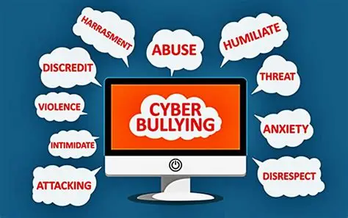
Cyberbullying and privacy issues
Online harassment among students
Sharing personal data without caution
Affects mental well-being and focus on studies

Slide 10

conclusion
Social media can boost or hinder education.
Mindful use helps maximize benefits.
Students must balance learning and social engagement.

Slide 11

THANK
YOU
Presented By : Pratham Joshi
Batch ID : 304

